Slide 1
Benefit of Natural Fiber Bags
Md. Abubaker Siddik
Roll number 01-50-08

Slide 2

Shafiq Agro Farm is a pioneering agricultural enterprise in Bangladesh, dedicated to producing high-quality natural fiber bags. These bags are crafted from locally sourced jute and other natural fibers, reflecting our commitment to sustainability and environmental stewardship

Slide 3
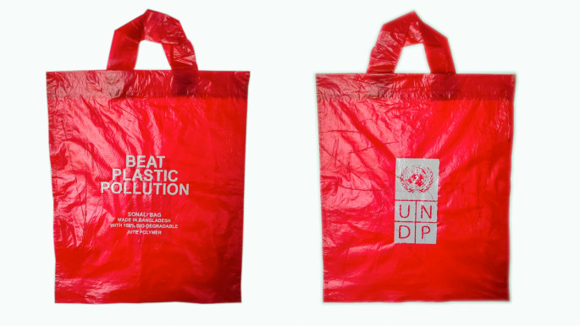
Environmental Benefits
Our natural fiber bags offer numerous environmental advantages
Unlike plastic bags, our natural fiber bags decompose naturally, reducing long-term environmental impact and helping to combat pollution.
By using renewable resources like jute, we help conserve non-renewable resources and promote sustainable agricultural practices.

Slide 4
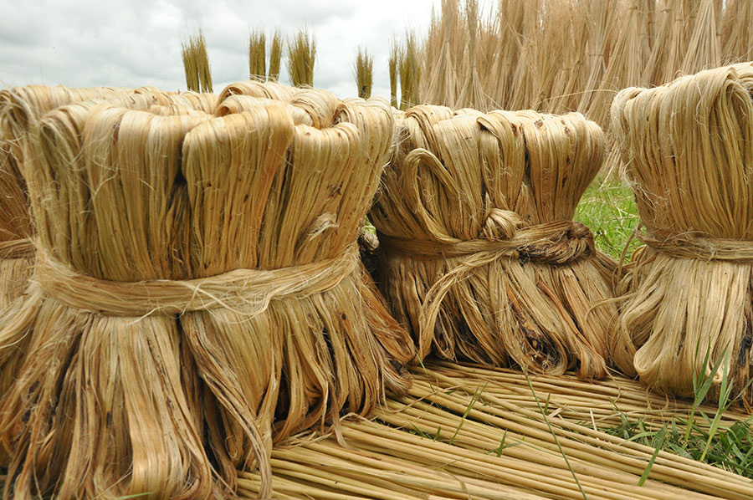
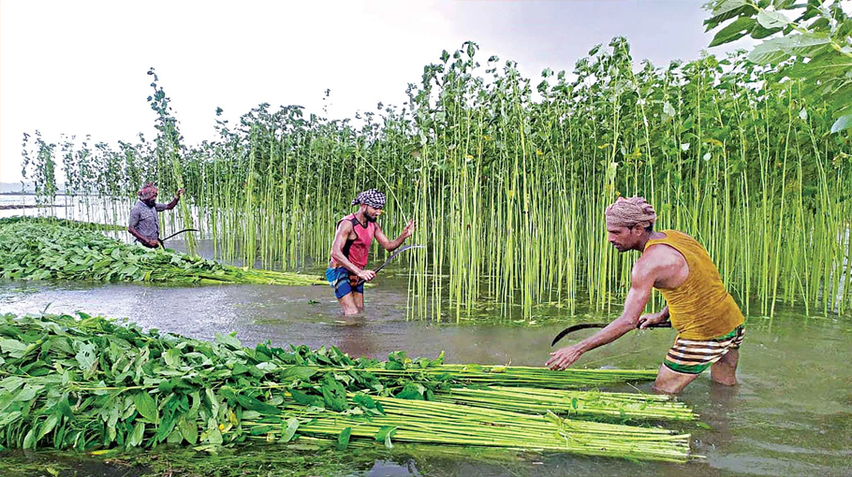
Economic and Social Impact
Shafiq Agro Farm plays a vital role in supporting the local economy
Support for Local Farmers
Job Creation

Slide 5

Health and Safety
Our natural fiber bags are safe and non-toxic
Free from harmful chemicals, our bags are safe for both humans and wildlife.

Slide 6
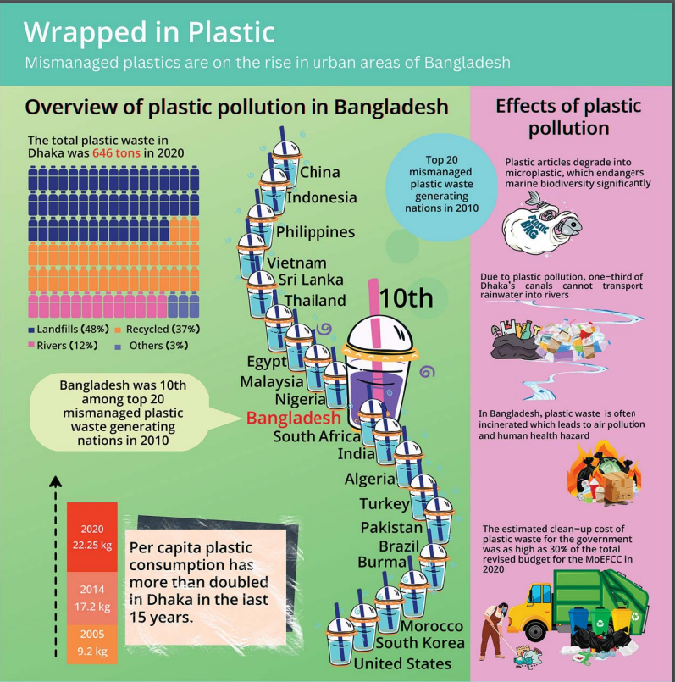

Slide 7
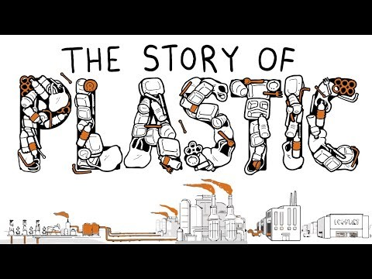
The story of Plastic

Slide 8
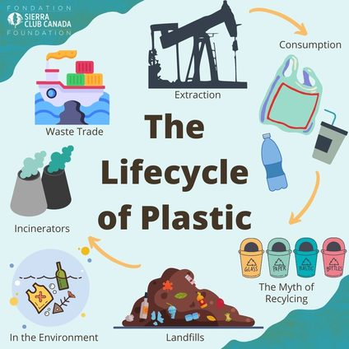

Slide 9
Plastic Pollution in Bangladesh
Plastic Waste in Dhaka 2020

Slide 10

Durability and Reusability
Our bags are designed for longevity and multiple uses
Capable of carrying heavy loads, our bags are strong and reliable.
Promoting a reduction in single-use bags, our products can be reused multiple times, minimizing waste.

Slide 11
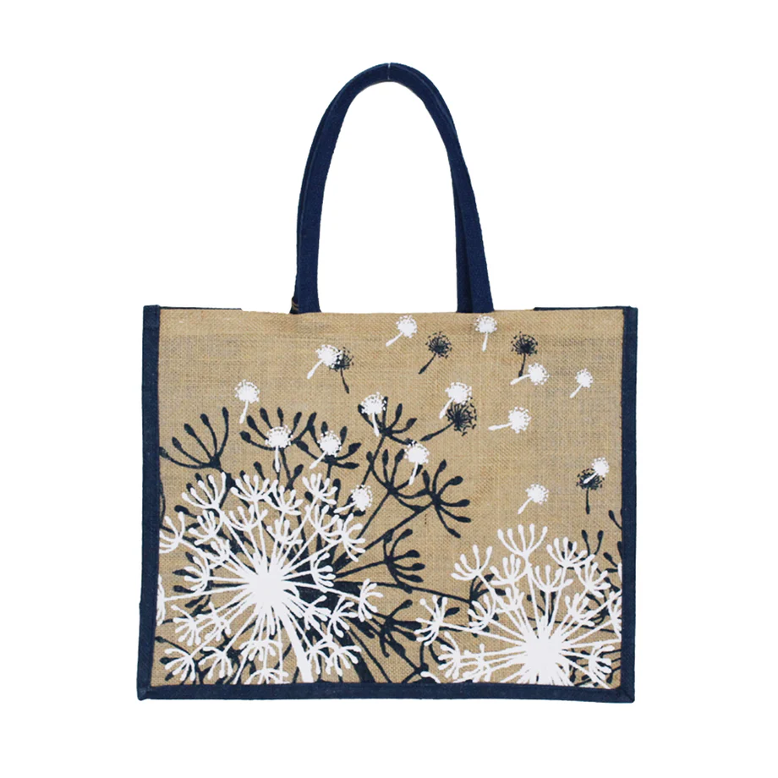

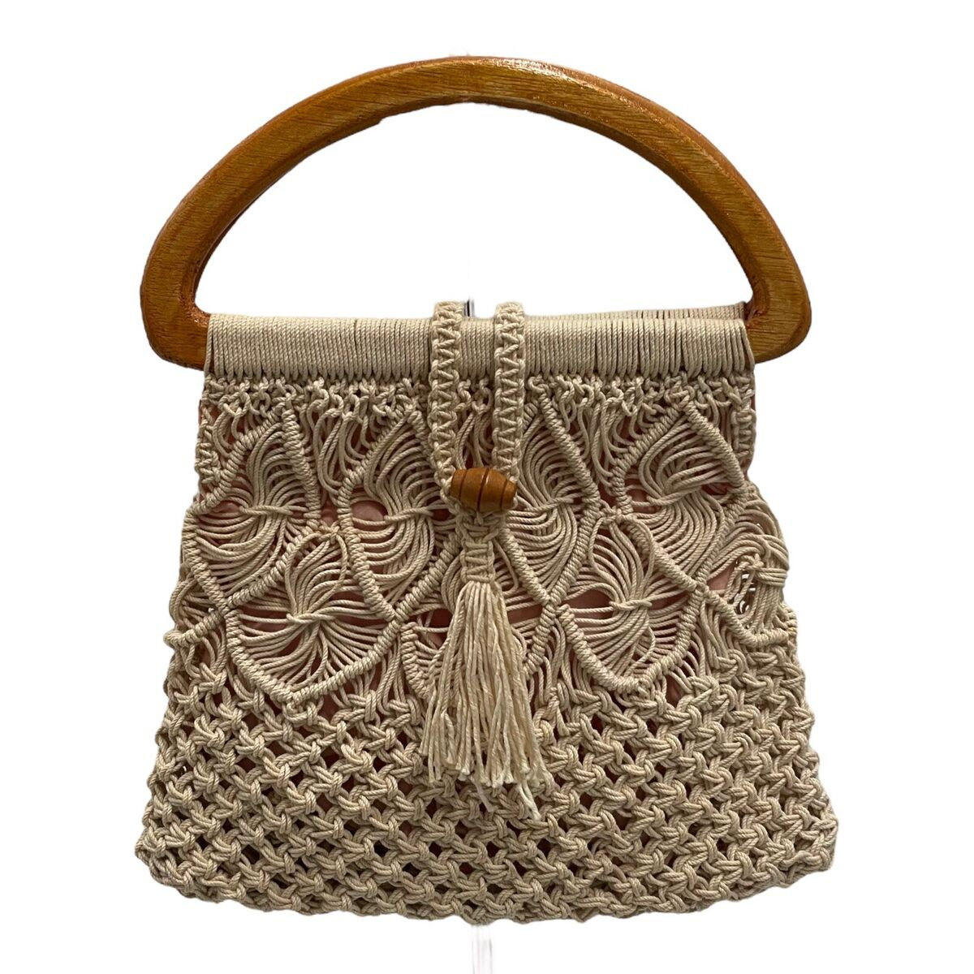
Cultural and Community Benefits
We take pride in our cultural heritage and community involvement:
Our bags support traditional crafts and the cultural heritage of Bangladesh.
Through community-based initiatives, we empower local communities and foster social cohesion.

Slide 12


Shafiq Agro Farm is committed to providing eco-friendly alternatives that benefit both the environment and the people of Bangladesh. Our natural fiber bags are a testament to our dedication to sustainability, economic development, and social responsibility.
Contact
01747186267
Barishal ,Bangladesh

